Slide 1
STEM Ambassador Impact Tool
Generating quantitative data to demonstrate impact
STEM Ambassador Impact Tool Guidance
The STEM Ambassador Impact Tool has been developed as a quick and easy method of collecting data about the impact your engagement has on the young people involved.
Young people will mark their agreement to four statements about engagement, aspirations, skills and careers using a 4-point scale.
You can submit the data you collect to your regional STEM Ambassador Hub (for Merseyside and Cheshire , this is All About STEM). They will collate the information and submit it to STEM Learning. Your volunteering will then contribute to the national picture of the impact of the STEM Ambassador Programme on young people.

Slide 2
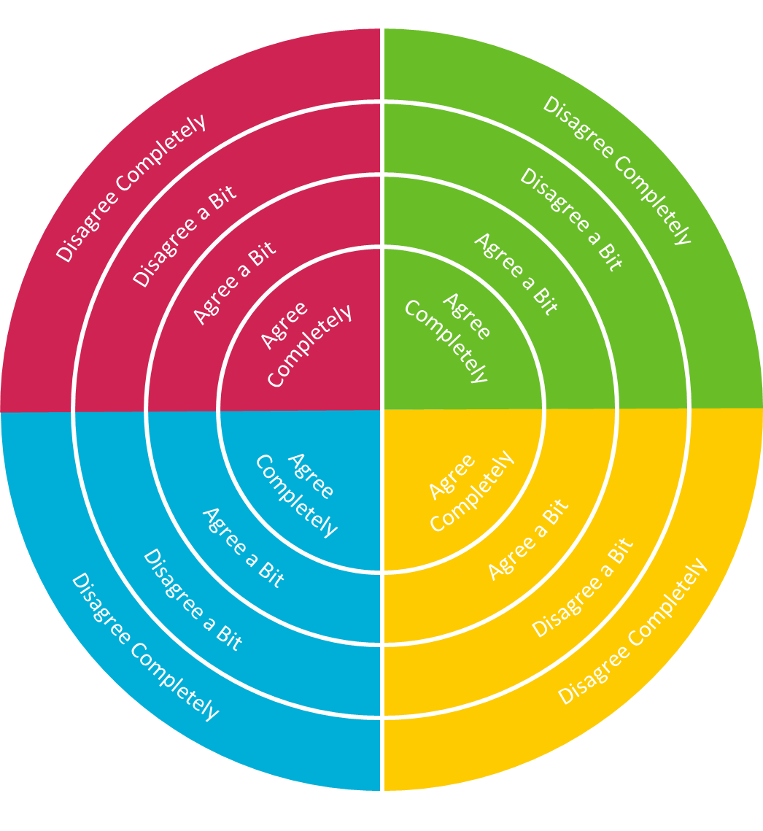
Impact Target
Generating quantitative data to demonstrate impact
Using the Target
There are a number of ways to use the tool to collect data from young people and you should use the method most appropriate for your engagement. However you choose to collect the data, the young people involved should always respond at the end of the engagement or activity.
It is recommended that you print one impact target and allow the young people to mark their agreement to each statement directly onto the printout using pens or stickers. If possible, you should distinguish between males and females by using different coloured pens/stickers (please avoid pink and blue). Depending on group size, one per table could work better!
Digital Alternatives
For ease of data collection, if the young people you are working with have access to internet connected devices they can provide feedback data using this link:
https://allaboutstem.survey.fm/student-impact-toolkit
Data Collection
If you use hard copied to collect student responses, please fill in this form to pass on your results to the hub.
https://allaboutstem.survey.fm/impact-toolkit
@allaboutSTEM
@MCSTEMHub

Slide 3
I would like to do another activity like this
This activity has made me consider a career in STEM
Disagree Completely
Disagree Completely
Disagree a Bit
Disagree a Bit
Agree a Bit
Agree a Bit
Agree
Completely
Agree
Completely
Agree
Completely
Agree
Completely
Agree a Bit
Agree a Bit
Disagree a Bit
Disagree a Bit
Disagree Completely
Disagree Completely
I’m interested in
learning more about the subject covered in this activity
I’ve gained new skills or knowledge from this activity
Notes:
Print to use

Slide 4
Impact Postcards
Generating qualitative data to demonstrate impact
STEM Ambassador Impact Postcard
The STEM Ambassador postcard has been developed for young people to provide more detailed feedback about a STEM Ambassador activity.
Using the Postcards
You could provide a postcard to each young person to collate their thoughts about an activity. Alternatively, you could print one A3 copy and ask young people to feedback on post it notes to stick on the large poster. Different colour post-its could be used for boys and girls to identify any areas of difference.
Digital Alternatives
For ease of data collection, if the young people you are working with have access to internet connected devices, students can access a digital form of the postcard and provide their responses here:
https://allaboutstem.survey.fm/student-postcards
Data Collection
If you collect hard copies of student comments on the postcards, please use this form to send any good examples of impact to the STEM Ambassador hub.
https://allaboutstem.survey.fm/impactpostcards
Alternatively, you could post the hard copies to All About STEM, Studio N, Digital House, 44 Simpson Street, Liverpool, L1 0AX.
@allaboutSTEM
@MCSTEMHub

Slide 5
Notes:
Print this page to collect comments from the young people

