Slide 1



Creating Careers
Moving ON
Virtual Live Events & Resources to support Y11 & Y13 students
7 June 2021 – 18 June 2021

Slide 2
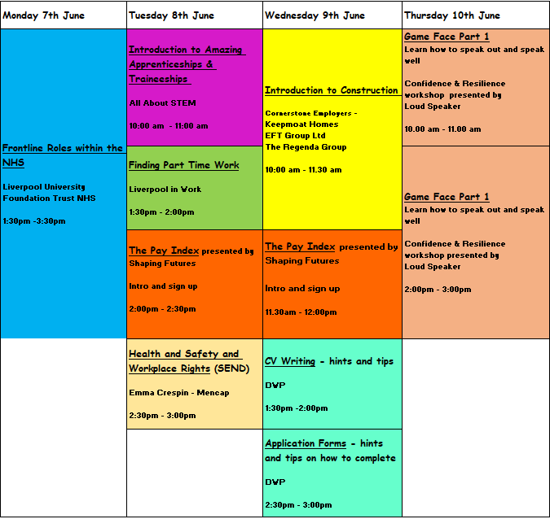
Week 1
Teacher notes:
Although this is focused on Years 11 and 13, other year groups are welcome to join us.
Zoom link:
https://us02web.zoom.us/j/83336282941?pwd=NUVjQ2oveEtnalh3NHliMkJORmxnUT09
Meeting ID: 833 3628 2941
Passcode: 812568
Game Face is the same session being delivered am & pm

Slide 3
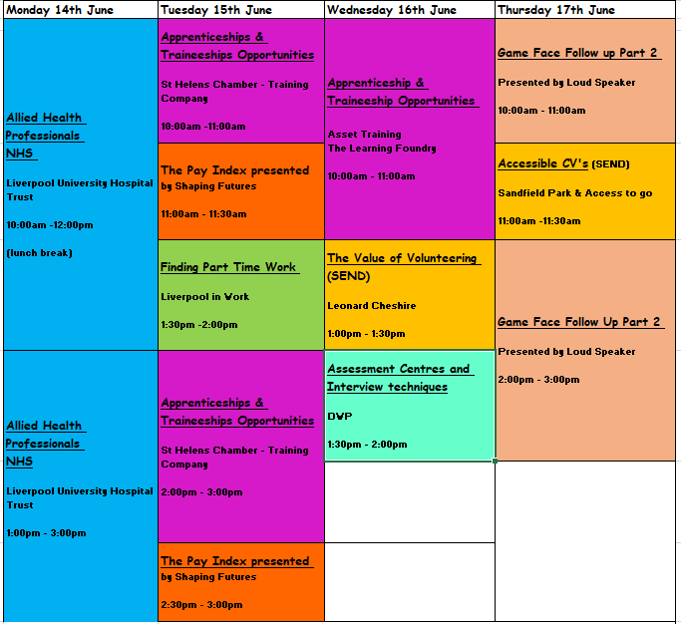
Week 2
Teacher notes:
Although this is focused on Years 11 and 13, other year groups are welcome to join us.
Zoom link:
https://us02web.zoom.us/j/83336282941?pwd=NUVjQ2oveEtnalh3NHliMkJORmxnUT09
Meeting ID: 833 3628 2941
Passcode: 812568
Game Face is the same session being delivered am & pm

